Slide 1
Lake Forest Park
Water District
Good Water, Naturally!
Education Module
#3 – What is an Aquifer?

Slide 3
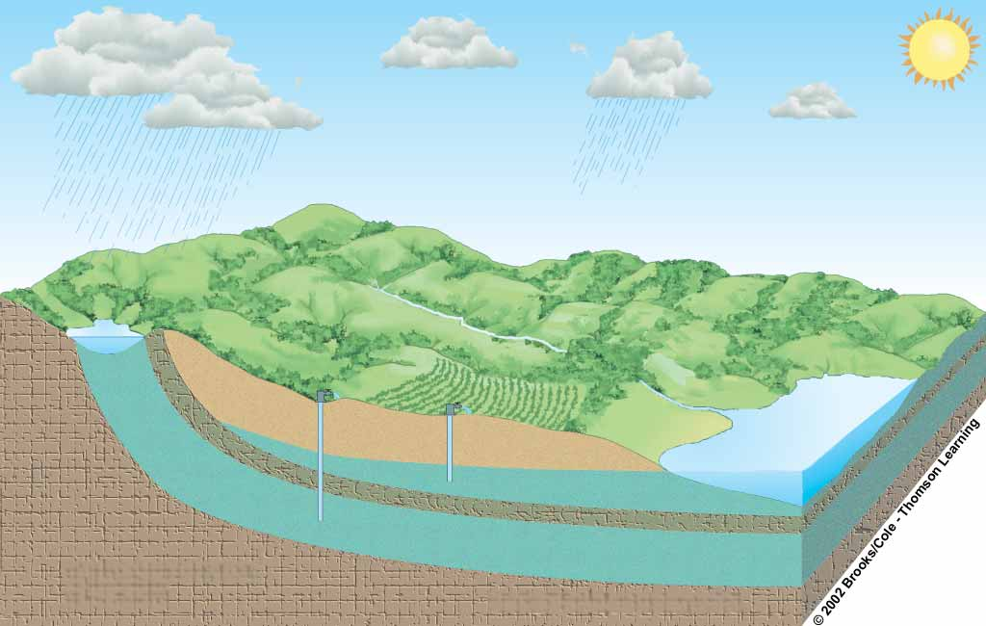
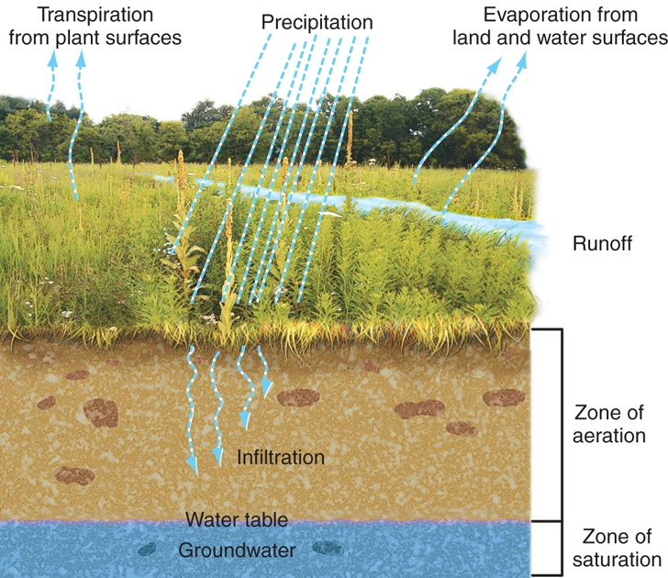
Where does the Water of Aquifers Come From?
Flowing
artesian well
Precipitation
Unconfined Aquifer Recharge Area
Well requiring a pump
Evaporation and transpiration
Confined
Recharge Area
Evaporation
Runoff
Aquifer
Stream
Infiltration
Water table
Lake
Infiltration
Unconfined aquifer
Less permeable material
such as clay
Confined aquifer
Confining permeable rock layer

Slide 4
Different Soils have different flow rates
Rock
Sand

